Slide 1
What do we have How do we communicate what we have
Usual zero-temperature constraints are provided with EoS’s. Do we need more of those? Usually, no finite-temperature constraints are provided with EoS’s. Add L-G critical point, …? Should EoS providers volunteer to document more constraints or be asked to do so? How often?.
Include “what has been done with model” in documentation?
Current 3rd dimension is Y_{Q}. What about Y_{I} , Y_{S} , … (which are useful for heavy-ion/lattice)?
What about magnetic fields? Also at finite temperature?
Remove 1/n_B from tables? replace .nb files?

Slide 2
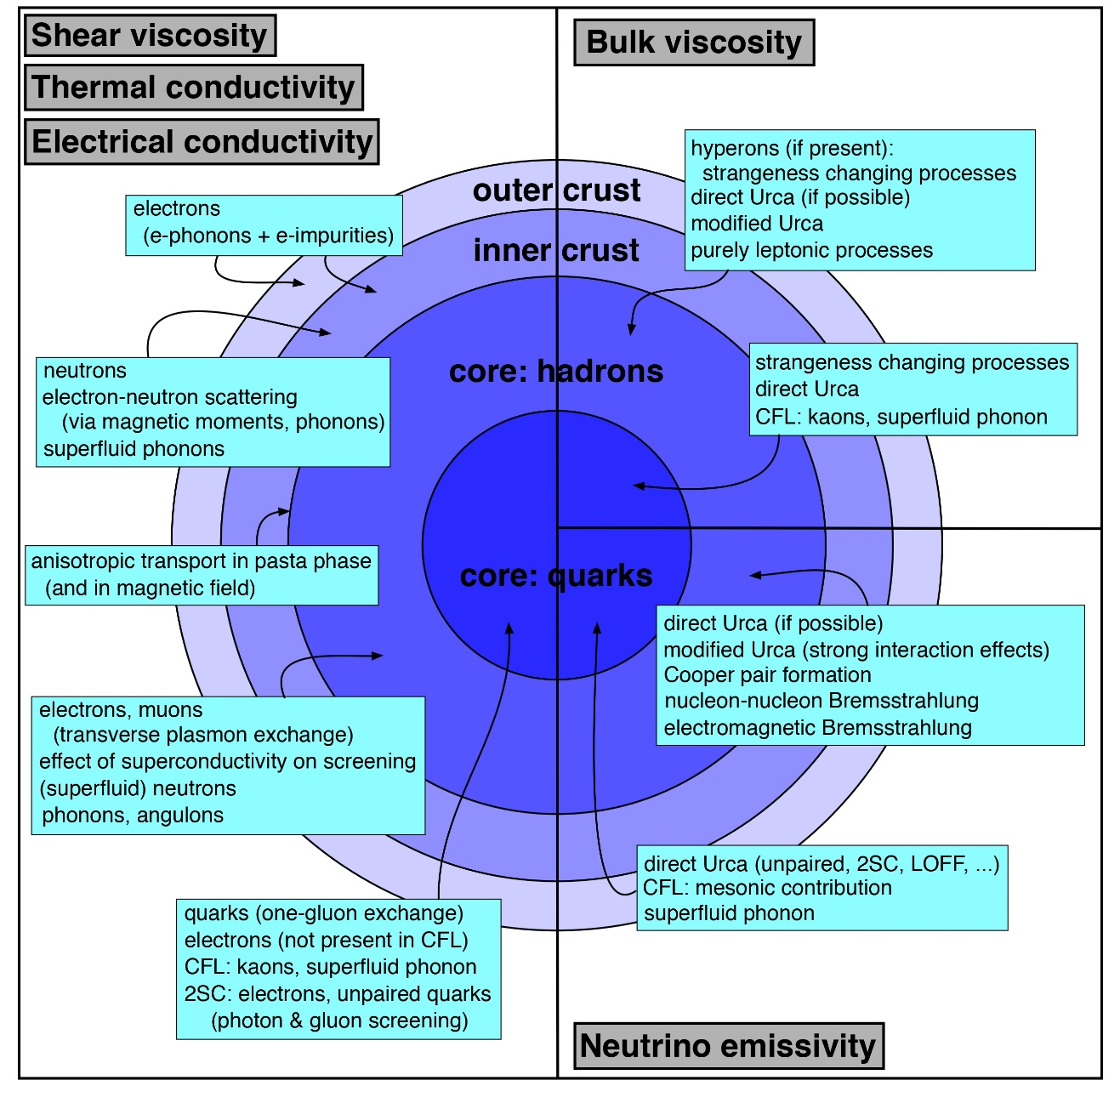
transport properties: what do we have?
figure by Andreas Schmitt
Q2: Which transport coefficients can be provided for simulations? How are they represented (tabular data, analytic functions)?
Subroutines available for practical use (e.g., crustal conductivities code by A.Y. Potekhin http://www.ioffe.ru/astro/conduct/index.html)
Practical expressions (e.g., Harutyunyan & Sedrakian 2016, eqs. (57)-(63))
Transport in cold neutron star matter (non-superfluid, superfluid)
Transport in hot neutron star matter (temperatures higher than 10 MeV)
Implementation of various phases of matter (nuclear, hypernuclear, quark matter, crust + core transition)
Anisotropic transport in strong magnetic fields (Hall effect, thermomagnetic and viscomagnetic effects, etc) – how relevant are these effects to be included in future simulations and what data is available on this?
Q1: Which transport phenomena have been included in numerical simulations so far? Resistivity, thermal conduction, viscosities?
Simulations of BNS mergers commonly use constant values for transport coefficients.

Slide 3
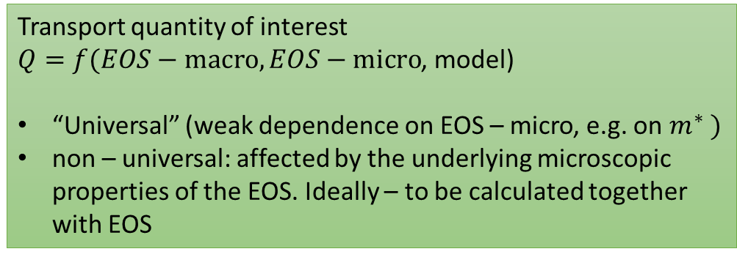
transport properties: how do we communicate what we have?
What we have: Various calculations on different levels of sophistication spread over the literature. Not easy to track. How to communicate the result?
Transport quantity of interest
$Q=f(EOS−\text{macro}, EOS−\text{micro}$, model)
“Universal” (weak dependence on EOS – micro, e.g. on $m^{∗} )$
non – universal: affected by the underlying microscopic properties of the EOS. Ideally – to be calculated together with EOS
Possible resolution(?)
Introduce transport section of CompOSE website?
Placeholder for collections of subroutines/references to relevant subroutines.
Should help modelling practitioners to get the quantities of choice without digging through the literature
Consistent EOS-transport calculations
Does the CompOSE data provide all necessary thermodynamic quantities for each EoS model required to compute the transport coefficients (e.g., particle fractions, chemical potentials, entropy density vs baryon density and/or temperature)? What about effective masses, Landau parameters?
Simultaneous calculations on the same microscopical basis (ideal future…). To which extent is this really required (sensitivity to the uncertainties)?

